Slide 1
Privacy Preserving Collaborative IDS for Internet of vehicle networks
Faculty Members: Student Members:
Mrs. Durga Hithesh Y
Mrs. Uma Saurabh Krishnan
Mrs. Anusuya
Mr. Praveen

Slide 2
Problem Statement
Challenges in Internet of Vehicles (IoV)
Increasing Cyber-Attacks on Connected Vehicles: Modern vehicles are vulnerable to in-vehicle network (IVN) exploits (e.g., DoS, Fuzzy, RPM, and Gear spoofing attacks) and V2X wireless threats.
Privacy Concerns in Sharing Vehicle Data: Strict data privacy regulations (e.g., GDPR, CCPA) prevent vehicles from uploading raw telemetry, location history, or sensor logs to centralized servers.
Limitations of Centralized IDS:
  Bandwidth bottlenecks from transmitting massive, continuous streams of high-frequency vehicular data.
  Single point of failure: vulnerability to connection drops in high-mobility environments.

Slide 3
Proposed Solution: FedIoV
Federated Learning (FL) Framework: Enables collaborative training where vehicles train intrusion detection models locally and only share encrypted model updates (gradients) with the server.
Kolmogorov-Arnold Network (KANConvNet): A lightweight, edge-optimized classifier with learnable activation functions on edges rather than nodes, reducing computational overhead.
Layer-Wise Fully Homomorphic Encryption (FHE): Selectively encrypts only the most sensitive layers of the KAN model during aggregation, resolving the speed limitations of traditional FHE while preserving privacy.

Slide 4
Project Objectives
Design a Collaborative IDS for IoV: Develop a distributed, cooperative system to detect cyber threats across the fleet without requiring a central database of raw logs.
Preserve Privacy of Vehicle Data: Leverage secure cryptographic channels and Layer-Wise FHE to ensure vehicle telemetry remains private.
Support Distributed Learning Across Vehicles: Build a robust Federated Learning client-server architecture capable of handling vehicle churn, communication drops, and non-IID settings.
Detect Vehicular Cyber Attacks Efficiently: Implement and optimize KANConvNet to detect low-latency attacks (target latency <60<60 ms) on resource-constrained Electronic Control Units (ECUs).

Slide 5
Threat Model
In-Vehicle Adversary (ECU/CAN Level): Attackers with physical or remote access who compromise an ECU to inject malicious payloads, bypass authentication, or disrupt communications (e.g., DoS, Fuzzing, Impersonation).
Byzantine Clients (FL Level): Compromised vehicles in the federated fleet that act maliciously to corrupt the global model by uploading poisoned gradients, scaled updates, or flipped labels.

Slide 6
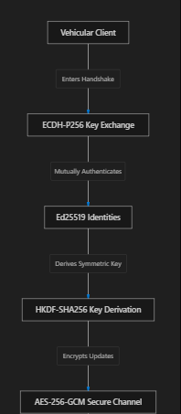
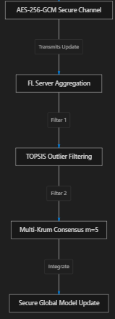
Secure Channels: ECDH-P256 key exchange, AES-256-GCM encryption, and Ed25519 signatures secure updates in transit.
Robust Aggregation (TOPSIS + Multi-Krum): The server filters out noisy/Byzantine updates using TOPSIS-based filtering, followed by Multi-Krum clustering (m=5m=5) to isolate and drop malicious outliers.
Local Differential Privacy (DP): Updates are clipped (∥Δθ∥2≤1.0∥Δθ∥2​≤1.0) and perturbed with Gaussian noise before transmission.

Slide 7
Dataset Acquisition
Car-Hacking Dataset (HCRL):
  Scope: Labeled CAN bus traffic from a real Hyundai YF Sonata.
  Size/Type: CSV logs containing CAN-ID, DLC, payload bytes, and injection flags.
  Threat Classes: Normal run, DoS, Fuzzy, RPM, and Gear attacks.
VeReMi Dataset:
  Scope: Kinematic beacon data from V2V communication in VANET simulations.
  Size/Type: 18 kinematic features (positions, speeds, accelerations, headings, noise levels).
  Threat Classes: Benign (BENIGN) and Attack (ATTACK) (falsified kinematic attributes).
3.CICIDS 2017 Dataset:
  Scope: Network flow-level traffic logs spanning multi-layer V2I and V2N network protocols.
  Size/Type: 78 numeric flow features down-selected to a stable 46-feature network baseline.
  Threat Classes: Benign vs. Attack (DDoS, PortScan, FTP-Patator, SSH-Patator, Web Attacks, etc.)
4.IEEE VTC-CAN Dataset:
  Scope: Labeled high-fidelity in-vehicle CAN bus log stream under attack injections.
  Size/Type: CAN frames windowed to 46-dimensional temporal descriptors.
  Threat Classes: Attack-free, DoS attack, Fuzzy attack, and Impersonation attack.

Slide 8
Justification
Coverage:
  Low-Level IVN Protection: Car-Hacking and IEEE VTC-CAN evaluate anomaly detection on the internal physical ECU bus (message intervals, ID distributions, payload integrity).
  High-Level V2V Protection: VeReMi evaluates system resilience to geographic and kinematic coordinate spoofing or communication misbehavior.
  High-Level V2I/V2N Protection: CICIDS 2017 evaluates broad network-layer threats (DDoS, brute-force exploits, scans) targeting external connectivity.
Realism & Data Heterogeneity: Incorporating these four distinct datasets tests the dataset-agnostic feature engineering layer and the robustness of KANConvNet across high-frequency binary sequences, continuous float vectors, and IP traffic metrics.

Slide 9
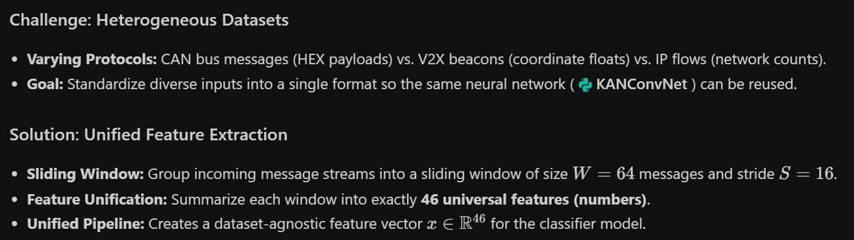
Data Engineering

Slide 10
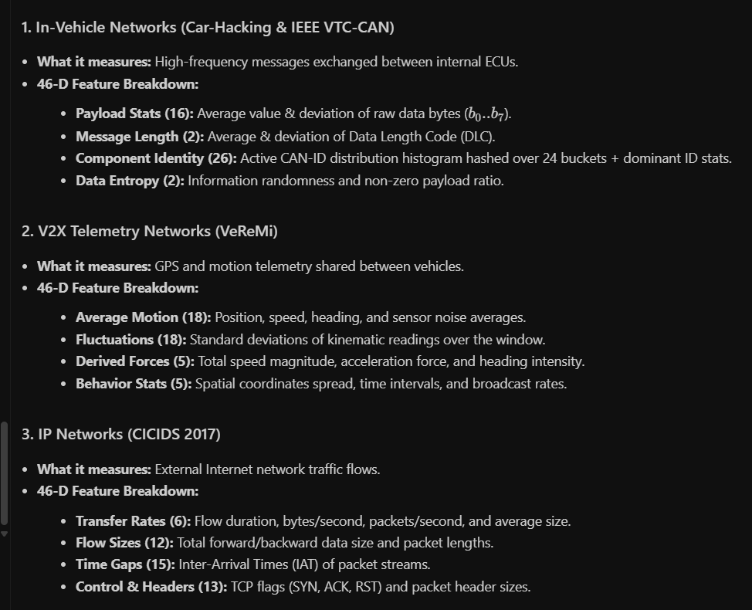
Data Engineering (46-D Feature Mapping)

Slide 11
Data Engineering (Preprocessing)
Data Cleaning Pipeline
Percentile Clipping: Continuous features are clipped at the 0.5th and 99.5th percentiles (using training set bounds) to remove noisy sensor spikes and outliers.
Z-score Standardization: Every feature is scaled to standard bounds.
Safeguarding Against Data Leakage (Anti-Cheating)
Centralized Stratified Split: 70% Train, 15% Validation, 15% Test.
Strict Training Isolation: Mean (μ) and standard deviation (σ) parameters are computed only on the 70% training split.
Evaluation Integrity: The calculated training statistics are locked and then used to scale validation and testing sets

Slide 12
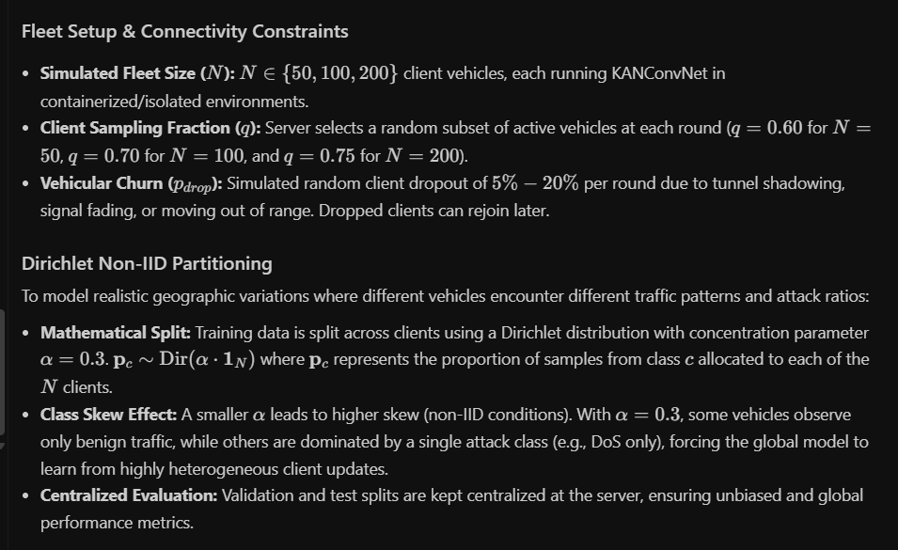
Non-IID Simulation

